Slide 1
“Something technical”
David Moody (acknowledging the assistance of Bob and Eileen Henderson and Dr. David Powell)

Slide 2
Cognitive decline in aging pilots
“The world’s fastest neuropsychology training course”
Presented by an Engineer!
(Literature survey, with expert commentary)
Notes:
Cognitive decline can affect anyone; my interest here is to see if we can justify using “age” as the variable to trigger our interest

Slide 3
Introductory questions
What are the objectives of this presentation?
What is cognitive decline?
Why is cognitive decline important and relevant to us?
Some important distinctions regarding cognition (Some neuroscience)
What cognitive functions are exercised when flying?

Slide 4
Objectives of this presentation
Distinguish “cognitive decline” versus “age” as a measure of flight performance
Background on the effect of aging on cognitive functions
Identify cognitive functions important for flying
Suggest “check list” items for BFR/ICR
Possible implications and interventions

Slide 5
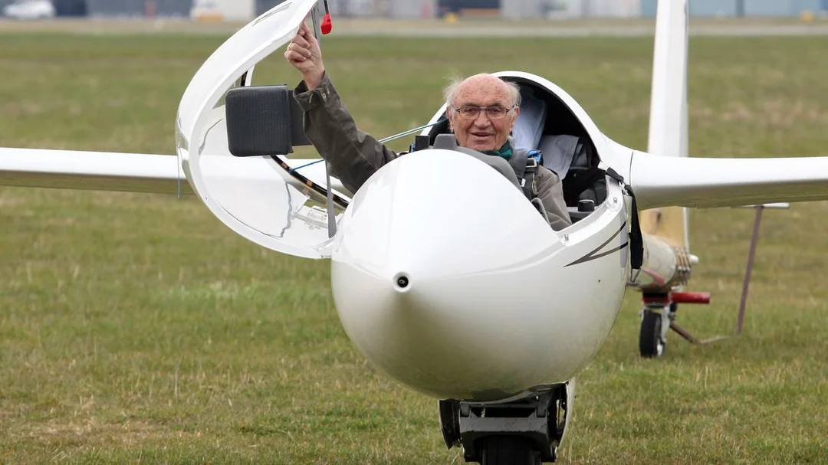

Slide 7
What is cognitive decline?
It depends –
From age 40 the brain shrinks by 5% per decade (see note)
Brain capacity and competence diminish
The catch-22 is that you won’t be aware of your diminished competence
The good news is that if you think you have Alzheimer's then you probably don’t (the awareness bit)
Note: Brain shrinking is from the work of the University of Auckland Centre for Brain Research
Notes:
Brain shrinking is from the work of the University of Auckland Centre for Brian Research

Slide 8
Minimising cognitive decline?
The brain uses 20% of your total O₂ intake
So, maintaining a healthy circulatory system is important
How – exercise 20-30 minutes per day and 5 times per week (see note 1)
Making your brain work is the other trick
How – by learning new skills and competencies – like a musical instrument or a language (see note 2)
“Exercise” is competent if the walking / exercising rate is sufficiently heavy as to prevent normal conversation = elevated heart rate and respiration
Learning an entirely new skill involves the whole cortex and stimulates brain elasticity – as the skill becomes habituated (i.e., well learnt) then the area of the cortex involved reduces
Notes:
“Exercise” is competent if the walking / exercising rate is sufficiently heavy as to prevent normal conversation = elevated heart rate and respiration
Learning an entirely new skill involves the whole cortex and stimulates brain elasticity – as the skill becomes habituated (ie well learnt) then the area of the cortex involved reduces

Slide 9
Cognitive Decline vs Crystallised Intelligence
It is true – you get “old and cunning”
With experience you gain knowledge and expertise
Klein (see note 1) called this “Naturalistic Decision-Making”
Expert decision makers (see note 2) do not consider multiple options, rather they:
recognise patterns from experience
rapidly select an action that was successful in the past
then adjust future actions in response to the impact of their initial decisions
However, dealing with new “unique” situation requires higher level cognitive functions (see note 3)
Klein, GA. And Zsambok, CE (1997), Naturalistic Decision Making
Klein studied Fireman, Police, top sportspersons and Military decision makers – people who often must make decisions under stress and in very limited time
A lack of experience due to youth or starting an activity late in life, may mean that one is trying to decide in a hurry when there is no relevant pattern in one’s experience. It is this situation which exposes reduced cognitive competence.
Notes:
Klein, GA. And Zsambok, CE (1997), Naturalistic Decision Making
Klein studied Fireman, Police, top sportspersons and Military decision makers – people who often have to make decisions under stress and in very limited time
A lack of experience due to youth or starting an activity late in life, may mean that one is trying to make a decision in a hurry when there is no relevant pattern in one’s past experience. It is this situation which exposes reduced cognitive competence.

Slide 10
Why is cognitive decline important and relevant to us?

Slide 11
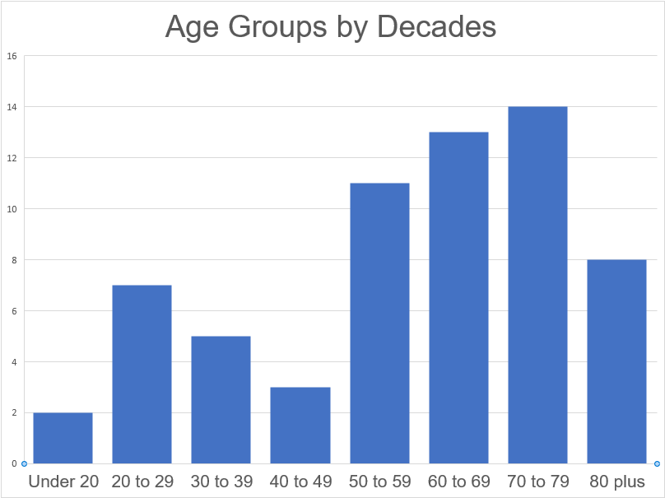

Slide 12
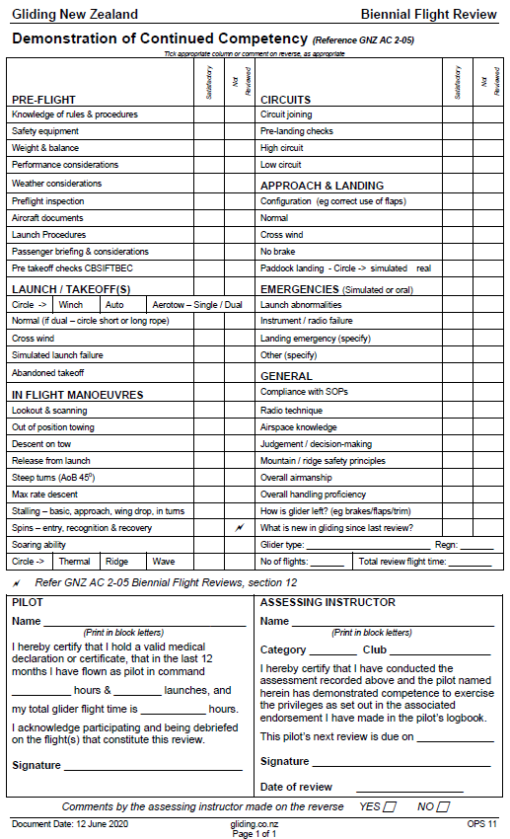
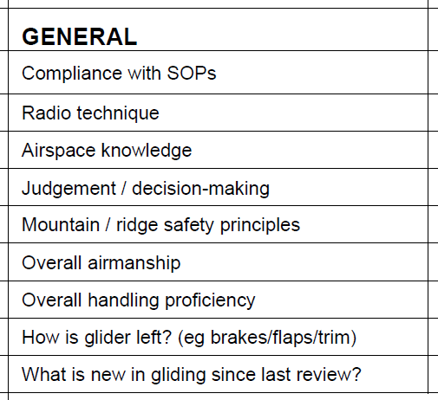

Slide 13
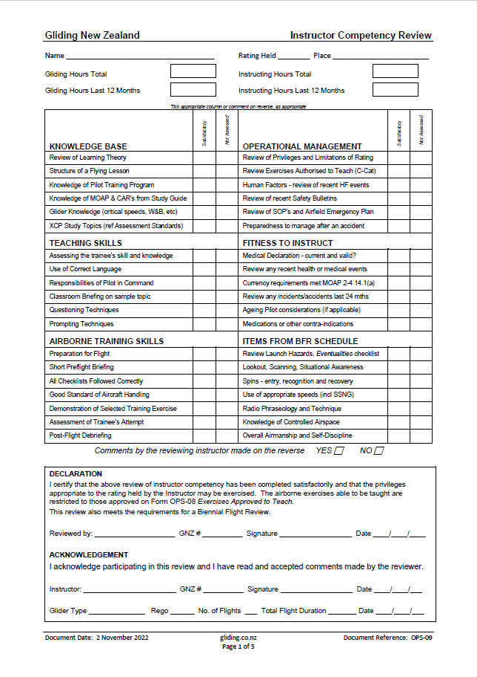
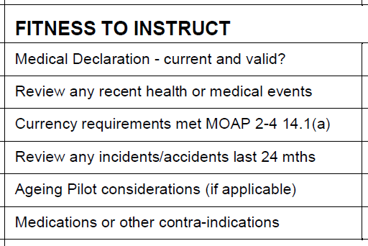

Slide 14
Why is cognitive decline important and relevant to us?
The big risk is not incapacitation but subtle cognitive decline
This is a topic under active discussion at EASA FAA and ICAO
Political/industrial considerations drove the "age 60" and then "age 65“ limits for commercial pilots
The medical is not a good place to detect subtle cognitive decline; flight instructors are far better placed to detect this in older pilots
Certainly, you can't rely on the pilot telling us, because they may have no insight into what's happening
Incapacitating conditions, SHOULD be declared but of course often won't be.
Dave Powell is a medical doctor, trained as an anaesthetist and then moved in aviation medicine where he is a well-respected global figure and advisor to IATA. He is also a PPL and routinely flies.
Notes:
Dave Powell is a medical doctor, trained as an anaesthetist and then moved in aviation medicine where he is a well-respected global figure and advisor to IATA. He is also a PPL and routinely flies.

Slide 15
Why is cognitive decline important and relevant to us?
According to our hypotheses and other authors (Li et al., 2002; Rebok et al., 2009), analysis that controlled for cognitive effects showed that chronological age per se was not a relevant variable to predict piloting performance. Schroeder et al. (2000) has pointed out the necessity to use neuropsychological tests rather than relying on age.
Mickaël Causse, Frédéric Dehais, Mahé Arexis & Josette Pastor (2011): Cognitive aging and flight performances in general aviation pilots, Aging, Neuropsychology, and Cognition, DOI:10.1080/13825585.2011.586018

Slide 16
Why is cognitive decline important and relevant to us?
“The psychological literature shows definite age-related changes in certain cognitive functions that have been identified to be essential for flight performance (e.g.,
perceptual processing,
certain aspects of memory performance , and
certain psychomotor control).
The cognitive functions that do not yet exhibit clear effects of age tend to be the more complex ones that involve several stages of information processing such as problem solving, decision making, and time-sharing:
the more complex the performance, the larger the age effect tends to be.
complex performance developed through extensive training is found to be more resistant to negative age effects.”
Tsang, Pamela S. Age and pilot performance. In Aviation Training: Learners, Instruction and Organization, edited by Ross A. Telfer and Phillip J. Moore. Aldershot: Avebury Aviation, 1997. Pages 21-39.
Quoted in AGING AND THE GENERAL AVIATION PILOT, Research And Recommendations, AIR SAFETY INSTITUTE, A DIVISION OF THE AOPA FOUNDATION, 421 AVIATION WAY, FREDERICK, MD 2170.

Slide 17
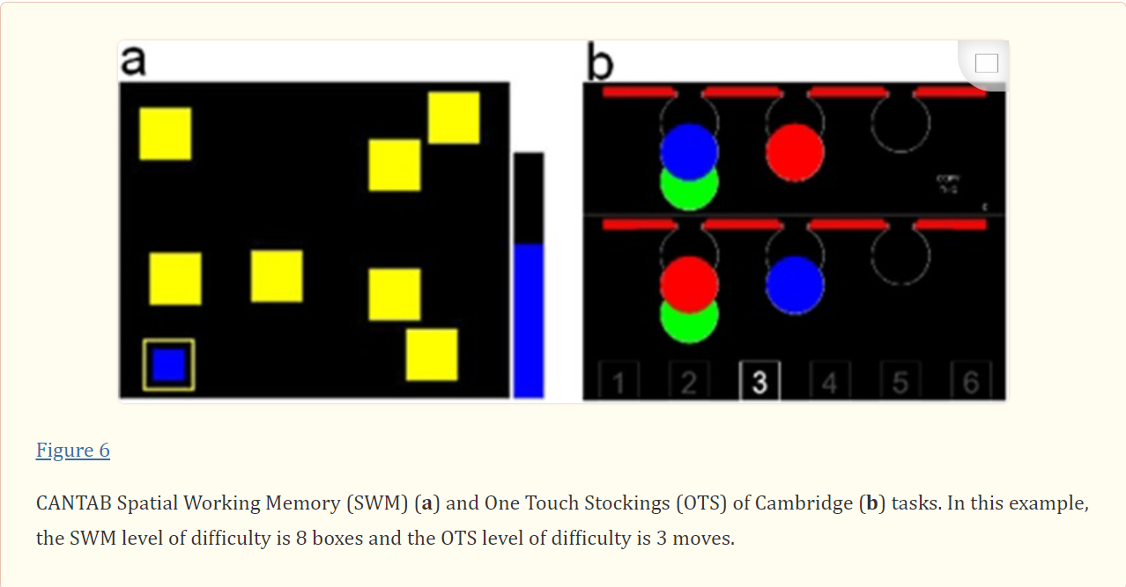
Influences of age, mental workload, and flight experience on cognitive performance and prefrontal activity in private pilots: a fNIRS study Mickaël Causse, 1 Zarrin K. Chua,1 and Florence Rémy2,3 , PubMed Central.

Slide 18
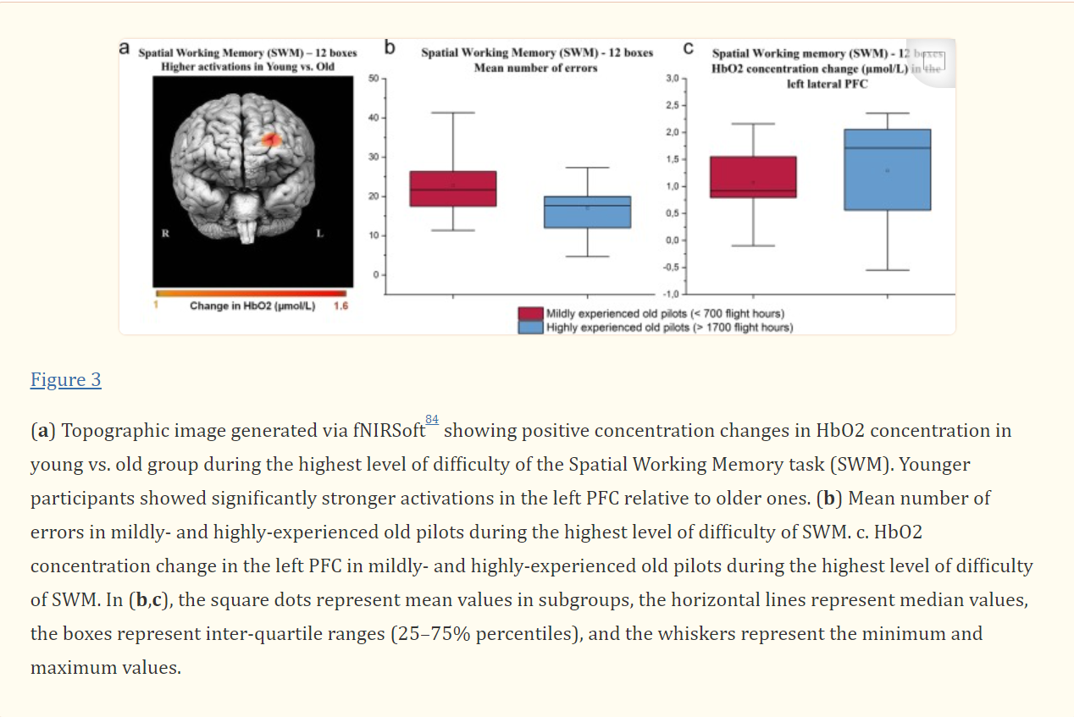

Slide 19
What cognitive functions are exercised when flying?
Aviate – Navigate - Communicate

Slide 20
Executive Functions
Despite their broad nature, four core EFs have been established based on behavioural and neural studies:
working memory updating,
set-shifting,
response inhibition, and
conflict monitoring (Miyake et al., 2000; Enriquez-Gepperta et al., 2010).
Quoted in: Executive functions and flying performance in pilots
Diede Smita,b *, Stefanie Enriquez-Gepperta,c *, Negin Daneshniaa, Alex Lafontd , & Frédéric Dehaisd
a Department of Clinical and Developmental Neuropsychology, University of Groningen, the Netherlands
b Research School of Behavioural and Cognitive Neurosciences, University of Groningen, the Netherlands
c Department of Biomedical Sciences of Cells & Systems, University Medical Center Groningen, the Netherlands
d ISAE-SUPAERO, University of Toulouse, France

Slide 21
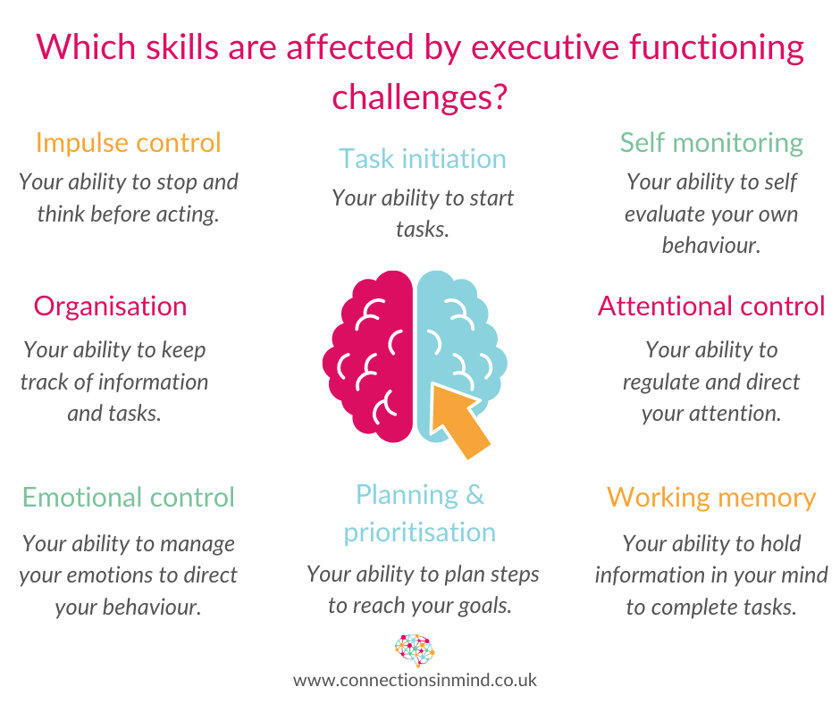

Slide 22
“The medical is not a good place to detect subtle cognitive decline, and flight instructors are far better placed to detect this in older pilots”.
-David Powell

Slide 23
How might flight instructors detect “subtle cognitive decline”? 4 particular elements of EF:
working memory updating,
set-shifting,
response inhibition, and
conflict monitoring
Missing radio calls
Drifting out of gliding range
Distracted by irrelevant stuff
Forgetting e.g. pre-landing checks
“Behind the aircraft”
Ignoring thermal cues

Slide 24
Possible interventions - hardware
Prompts for checklists
Kneepad for notes
“Say again” function on radio
Flarm to assist situational awareness

Slide 25
Possible interventions - software
Maintain physical health
Sleep
Exercise
Diet
Hydration
Risks (alcohol, smoking)
Maintain brain health
Good social connections
Learning something new

Slide 26
Cognitive decline in aging pilots
Distinguish “cognitive decline” versus “age” as a measure of flight performance
Background on the effect of aging on cognitive functions
Identify cognitive functions important for flying
Suggest “check list” items for BFR/ICR
Possible implications and interventions

